Slide 1
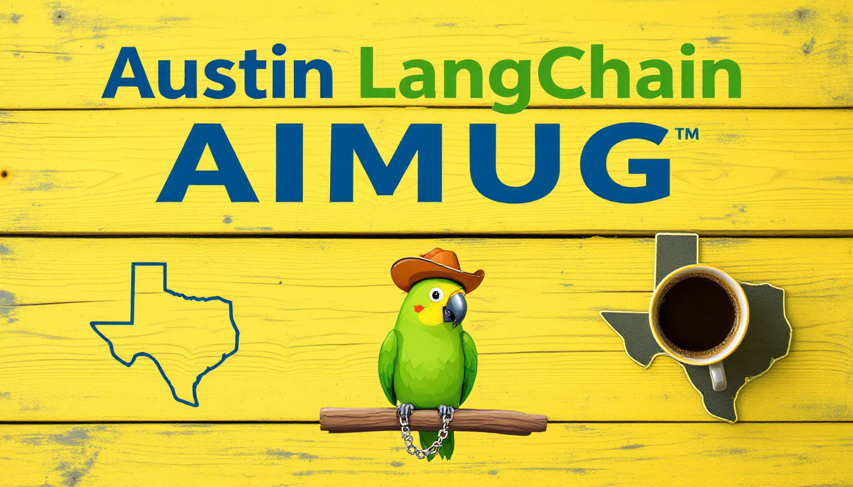
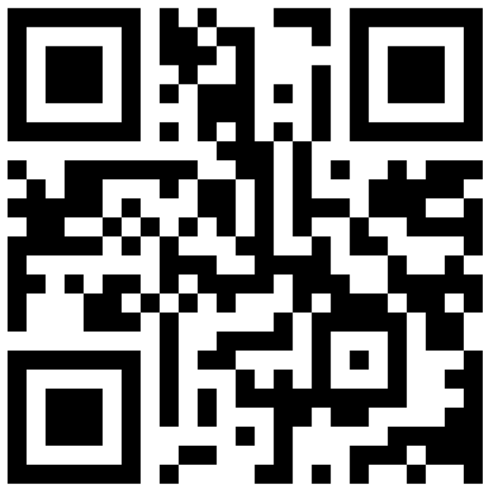

Slide 2

Todays Agenda
Intros
News
Lightning Talks
Fast RTC Lab
Wrap up and after party upstairs at The Tavern

Slide 3
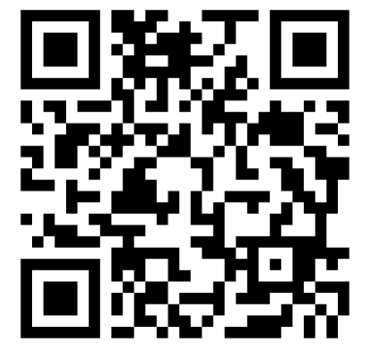
Thanks to our supporters
Center for Government and Civil Services – Space
LangChain – Pizza
Always Cool Brands – AV
Community – All the things

Slide 4
HI , I’m Colin McNamara
Entrepreneur: Co-founder of Always Cool Brands, focusing on private-label products and health-conscious goods (LangChain User)
Founding Member: Austin LangChain AIMUG
10% Developer Consulting Engineer, Cloud Builder, Casual Coder
Public Good: Helping our community succeed
LinkedIn:

Slide 5
Who we are
1200+ Members Strong: Connecting Austin’s tech, creative, and business leaders passionate about AI.
Learning in the Open: Leaning AI through the Lense of LangChain, pulling the ecosystem together.
Supportive & Engaged Community: A well-balanced Discord that’s "useful, but not overwhelming."

Slide 6
Learning in the Open – "Be Cool to Each Other" ✌️
Respect & Inclusivity: Our only rule is simple: “Be cool to each other, don’t be gross.”
AI Enthusiasts of All Levels Welcome: We celebrate diverse perspectives and unique paths in AI.

Slide 7
Where and when we meet 🌟📅
Monthly Showcases, Labs & Mixer - ACC RGC3000: Community members and vendors share projects, demos, and labs for hands-on learning.
Hacky Hours (ad hoc) - Rotating Local Bars: Informal happy hours at local spots; meet, discuss, and relax.
Weekly Virtual Syncs - Online: Tuesdays at 5PM – Workshopping, problem-solving, and AI discussions.

Slide 8
Where to Connect & Stay Updated 📲
Website: aimug.org – All things LangChain and AIMUG.
Discord: Join us for ongoing conversations.
GitHub: Austin LangChain Repo – Check out our open-source projects.
Meetup: Austin LangChain Group
Twitter: @AustinLangChain – Latest updates and AI news.
YouTube: Austin LangChain Channel – Watch replays and tutorials.

Slide 9
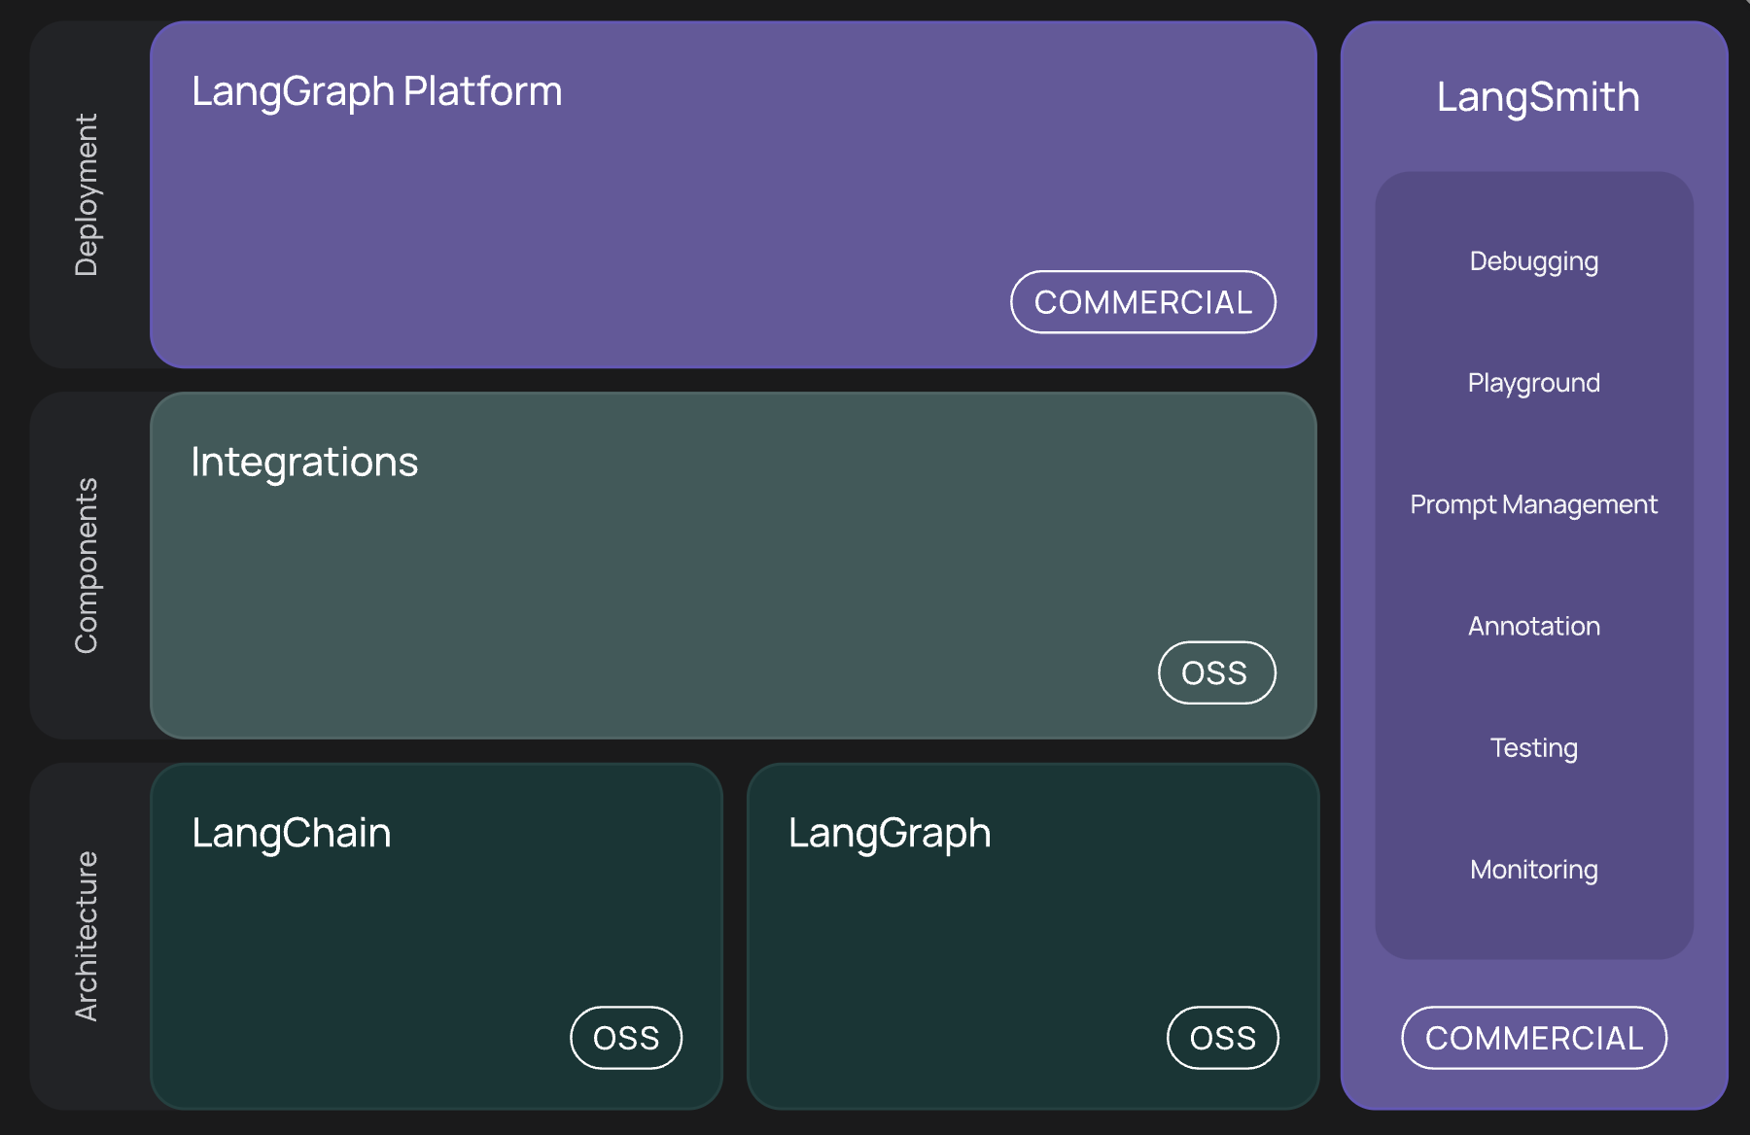
What’s LangChain

Slide 10
News – Models
QWEN3
Tool use at the MOE Layer
Ollama support!
Gemini 2.5 IO
1 Million Tokens
Tool Use
Llama 4
Voice optimized model
Gemini 2.5 IO
1 Million Tokens
Tool Use
Deepseek
Deepseek-VL – Mulimodal Reasoning

Slide 11
News – Hot MCPs
Amazon Q Developer CLI
AWS Environment Orchestration
Context7
Pull versioned documentation int your context window
Sanity MCP
Abstract your already abstracted CMS

Slide 12
News – Industry
Anthropic
4 billion from Amazon
Paper released – no clue what’s going on inside the LLM
Integrations for Claude (MCP) – Jira, Payal, Zapier
Cloudflare
Edge hosted MCPs
OpenAI
3 Billion to acquire Windsurf

Slide 13
News – Industry
Anthropic
4 billion from Amazon
Paper released – no clue what’s going on inside the LLM
Integrations for Claude (MCP) – Jira, Payal, Zapier
Cloudflare
Edge hosted MCPs
OpenAI
3 Billion to acquire Windsurf

Slide 14
News – LangChain / LangGraph / LangSmith
LangGraph – 0.4 released!
Upgrades for Interrupts
Interrupts surfaced automatically
Multiple Interrupts at once handled
LangSmith
Self Hosted 0.10
End to end OpenTelemetry support
Beta – LangGraph Cloud Control Panel
Beta – Full Text Search
Cloud
Performance Monitoring
LangChain
Multi-modal content blocks
Improved Retry Logic
Community – google calendar toolkit
Parsed reasoning support xAI / Ollama

Slide 15
Lightning Talks
ERP Automation - Joseph
Odoo
MCPs
Google A2A – Where does it fit - Colin
Google A2A
LangGraph
MCP

Slide 16
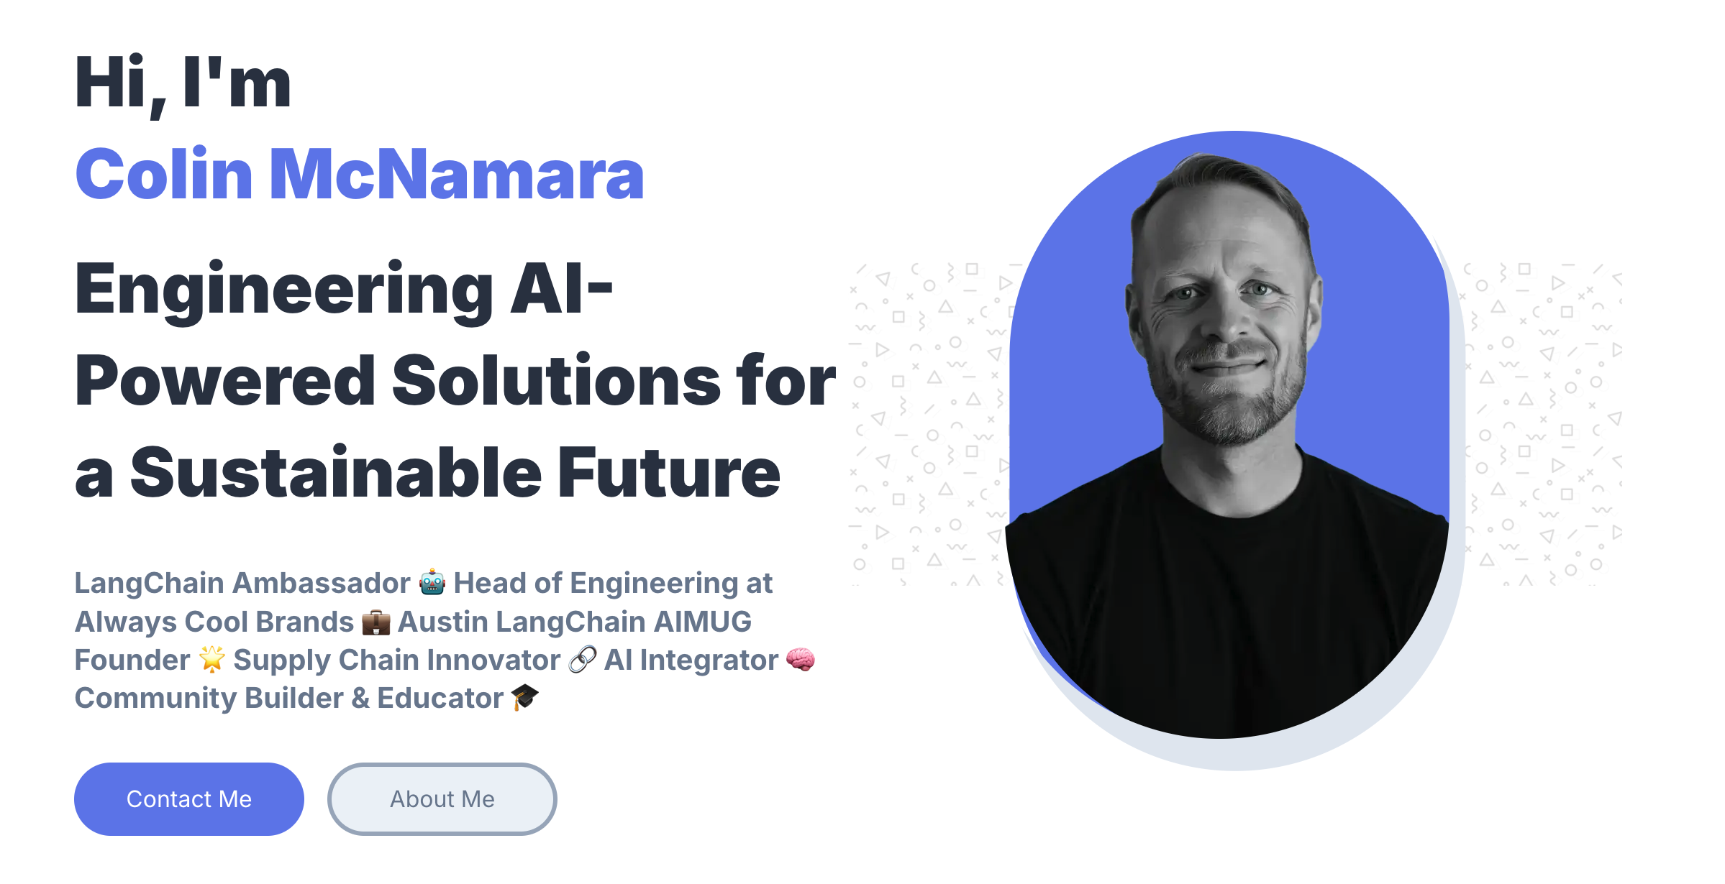
Lightning Talk – Google A2A – Colin McNamara
Notes:
A2A: Unlock collaborative agent-to-agent scenarios with a new open protocol¶
Seamless Agent Collaboration: Introduces a standard protocol for autonomous, opaque agents built on different frameworks and by various vendors to communicate and collaborate effectively with each other and with users, addressing the current lack of agent interoperability.
Simplifies Enterprise Agent Integration: Provides a straightforward way to integrate intelligent agents into existing enterprise applications, allowing businesses to leverage agent capabilities across their technology landscape.
Supports Key Enterprise Requirements: Offers core functionalities essential for secure, enterprise-grade agent ecosystems, including capability discovery, user experience negotiation, task and state management, and secure collaboration. Open standards for connecting Agents

Slide 17
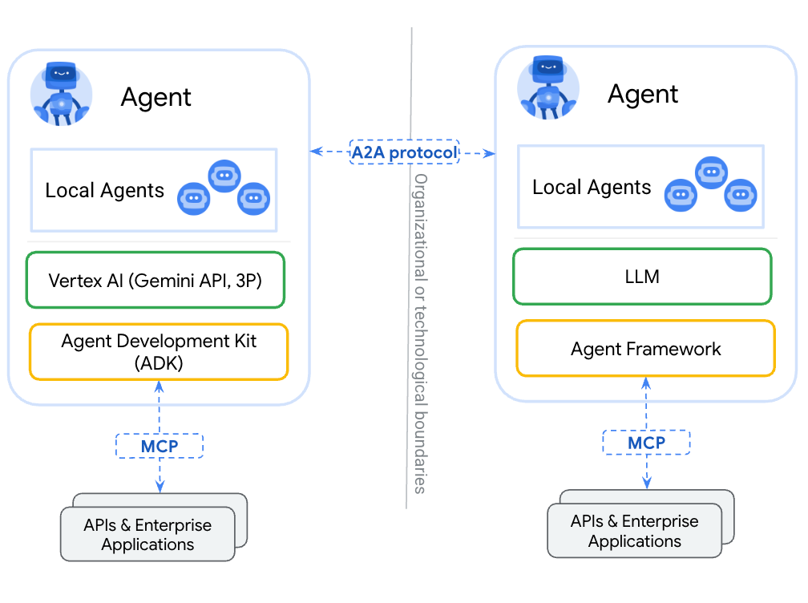
Why A2A – The agent interoperability Trap
Problem
Agent Graph interoperability
LangGraph, LlamaIndex, SmOL
Solution
Standardize intra AS Communication
Stats
50+ Partners
LangChain, Salesforce, More
Notes:
MCP (Model Context Protocol) for tools and resources
Connect agents to tools, APIs, and resources with structured inputs/outputs.
Google ADK supports MCP tools. Enabling wide range of MCP servers to be used with agents.
A2A (Agent2Agent Protocol) for agent-agent collaboration
Dynamic, multimodal communication between different agents without sharing memory, resources, and tools
Open standard driven by community.
Samples available using Google ADK, LangGraph, Crew.AI

Slide 18
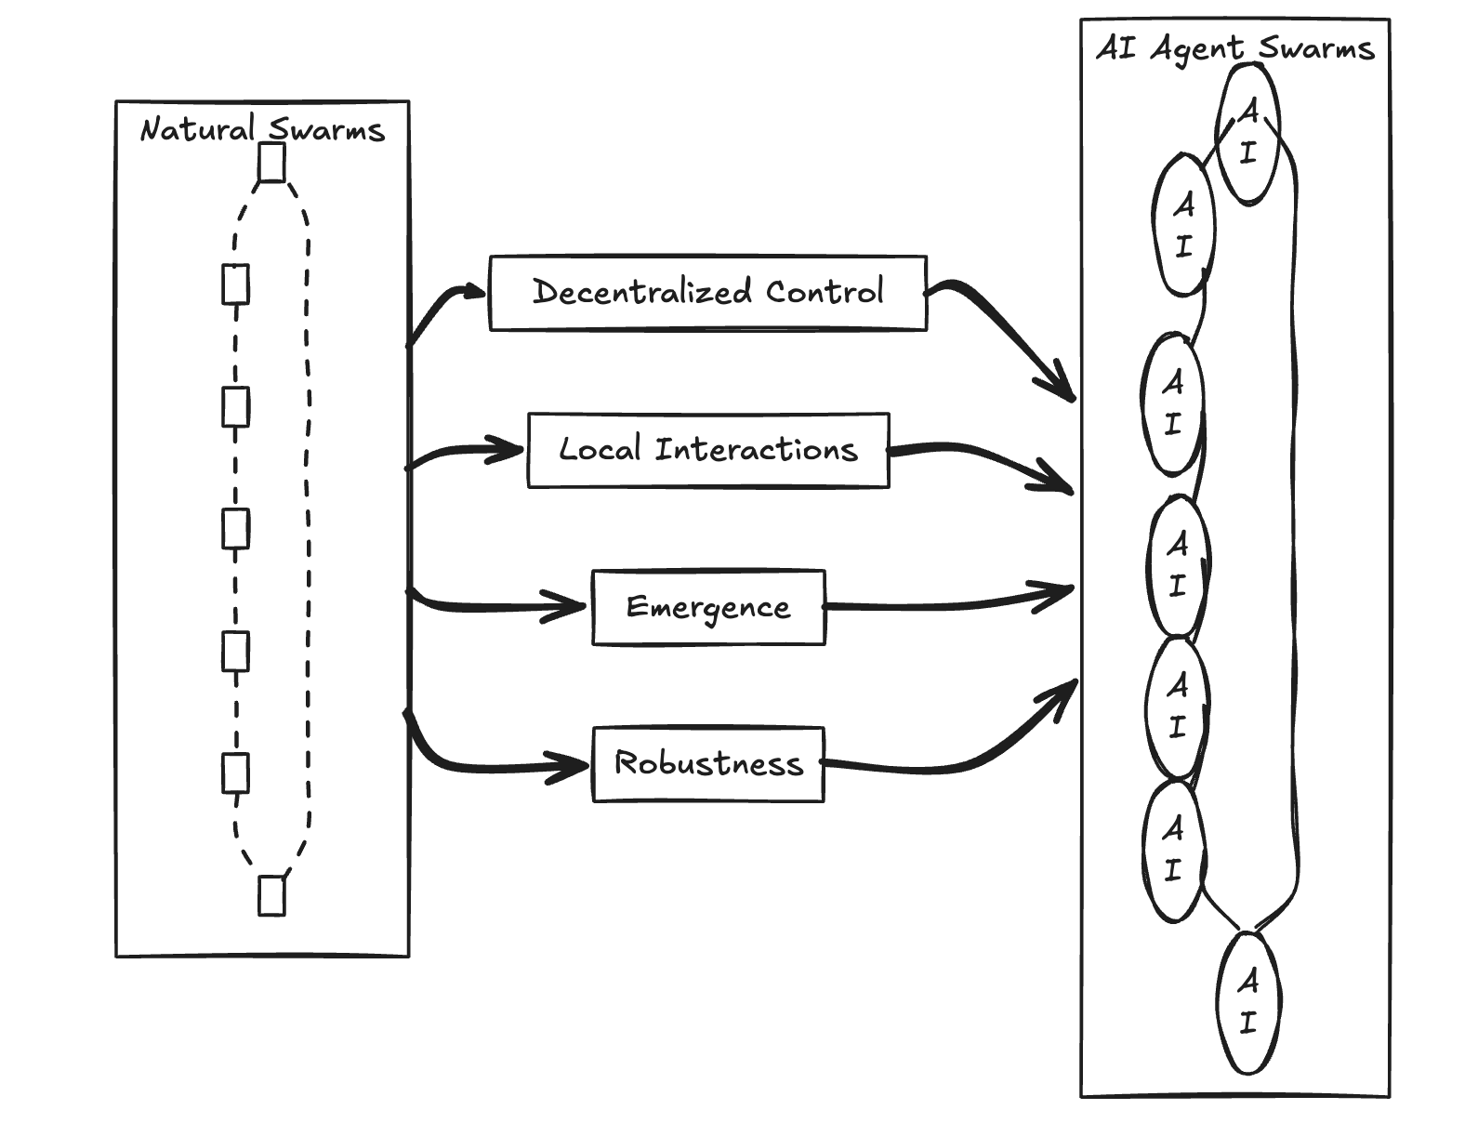
LangGraph + A2A = Modular Agent Orchestration
A2A – Connecting Swarms
Replaces Custom handoff code
No standardized events
Enables dynamic teams of agents/graphs
Fault Tolerance – Internet Protocol (retries)
Notes:
MCP (Model Context Protocol) for tools and resources
Connect agents to tools, APIs, and resources with structured inputs/outputs.
Google ADK supports MCP tools. Enabling wide range of MCP servers to be used with agents.
A2A (Agent2Agent Protocol) for agent-agent collaboration
Dynamic, multimodal communication between different agents without sharing memory, resources, and tools
Open standard driven by community.
Samples available using Google ADK, LangGraph, Crew.AI

Slide 19
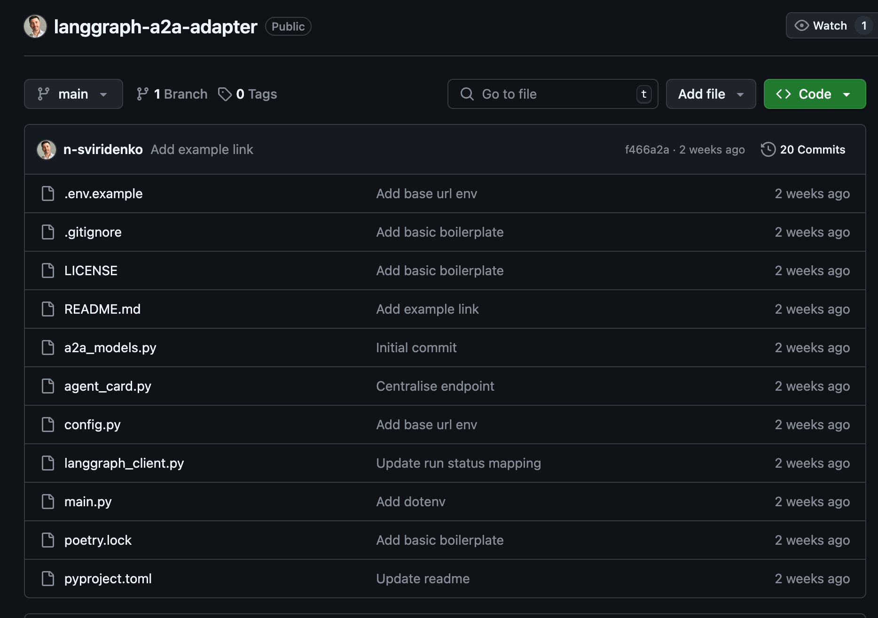
Connected Swarms – Federated Intelligence
LangGraph
Handles Workflow State
LangGraph, LlamaIndex, SmOL
A2A
Enables Cross Agent Messaging
Service Advertisement framework
Notes:
MCP (Model Context Protocol) for tools and resources
Connect agents to tools, APIs, and resources with structured inputs/outputs.
Google ADK supports MCP tools. Enabling wide range of MCP servers to be used with agents.
A2A (Agent2Agent Protocol) for agent-agent collaboration
Dynamic, multimodal communication between different agents without sharing memory, resources, and tools
Open standard driven by community.
Samples available using Google ADK, LangGraph, Crew.AI

Slide 20
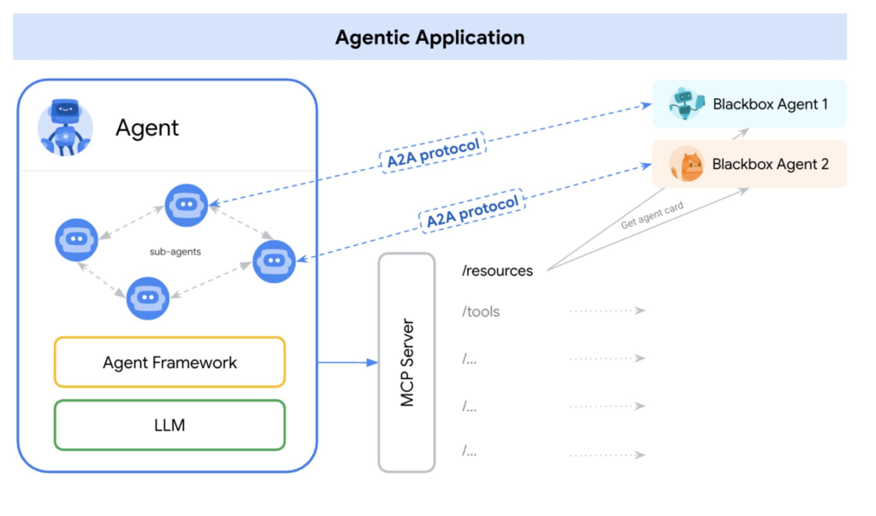
A2A vs MCP – Complementary Protocols
MCP: Agent <-> Tool
DB
API Access
Tool Access
A2A: Agent <-> Agent
Agentic Communication
Capabilities Discovery
Events
Combined Example
Agent uses MCP for data lookup
Uses A2A to delegate tasks
Passes task to another department
Notes:
MCP (Model Context Protocol) for tools and resources
Connect agents to tools, APIs, and resources with structured inputs/outputs.
Google ADK supports MCP tools. Enabling wide range of MCP servers to be used with agents.
A2A (Agent2Agent Protocol) for agent-agent collaboration
Dynamic, multimodal communication between different agents without sharing memory, resources, and tools
Open standard driven by community.
Samples available using Google ADK, LangGraph, Crew.AI

Slide 21
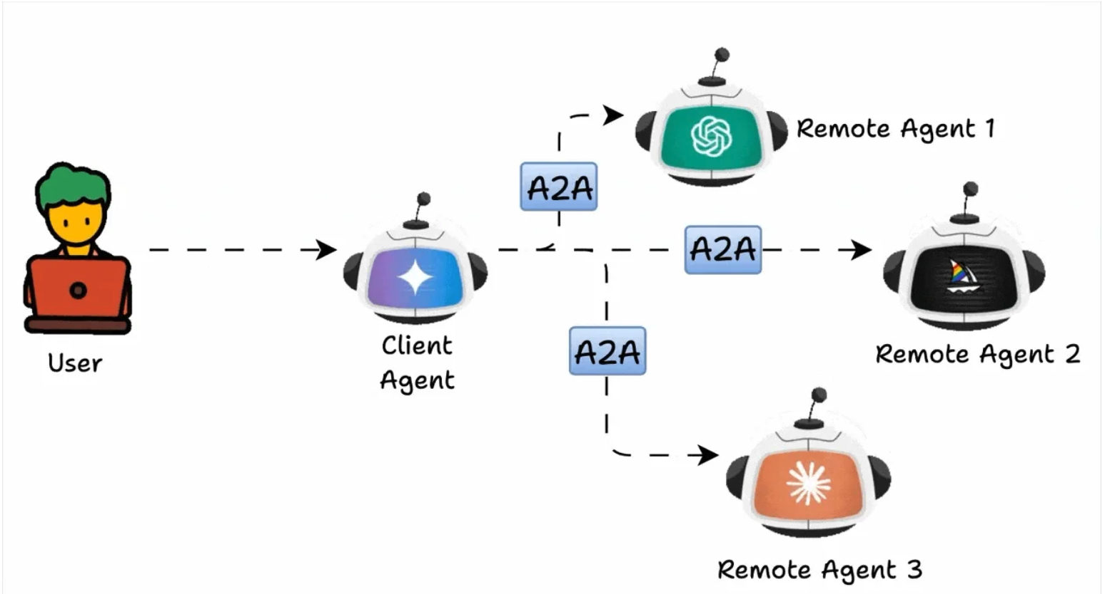
Real World Use Cases
HR Recruiting
Sourcing
Scheduling
Follow up Agents
Supply Chain
Inventory
Logistics
Vendor Agents
Customer Support
Triage
Specialist
Escalation
Notes:
MCP (Model Context Protocol) for tools and resources
Connect agents to tools, APIs, and resources with structured inputs/outputs.
Google ADK supports MCP tools. Enabling wide range of MCP servers to be used with agents.
A2A (Agent2Agent Protocol) for agent-agent collaboration
Dynamic, multimodal communication between different agents without sharing memory, resources, and tools
Open standard driven by community.
Samples available using Google ADK, LangGraph, Crew.AI

Slide 22
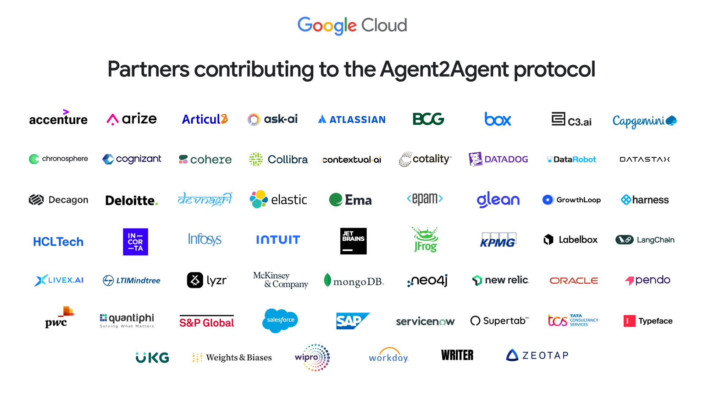
A2A Ecosystem
Trend
Specialized
Vs monolithic
Industry Support
Consulting
BPO
Platform
Opportunity
Engage Early
Implement Patterns
Learn as A2A Scales
Notes:
MCP (Model Context Protocol) for tools and resources
Connect agents to tools, APIs, and resources with structured inputs/outputs.
Google ADK supports MCP tools. Enabling wide range of MCP servers to be used with agents.
A2A (Agent2Agent Protocol) for agent-agent collaboration
Dynamic, multimodal communication between different agents without sharing memory, resources, and tools
Open standard driven by community.
Samples available using Google ADK, LangGraph, Crew.AI

Slide 23
Lightning Talk – Google A2A
Notes:
A2A: Unlock collaborative agent-to-agent scenarios with a new open protocol¶
Seamless Agent Collaboration: Introduces a standard protocol for autonomous, opaque agents built on different frameworks and by various vendors to communicate and collaborate effectively with each other and with users, addressing the current lack of agent interoperability.
Simplifies Enterprise Agent Integration: Provides a straightforward way to integrate intelligent agents into existing enterprise applications, allowing businesses to leverage agent capabilities across their technology landscape.
Supports Key Enterprise Requirements: Offers core functionalities essential for secure, enterprise-grade agent ecosystems, including capability discovery, user experience negotiation, task and state management, and secure collaboration. Open standards for connecting Agents

Slide 24
Lightning Talk – Google A2A

Slide 25
Lightning Talk – Google A2A

Slide 26
Lightning Talk – Google A2A

Slide 27
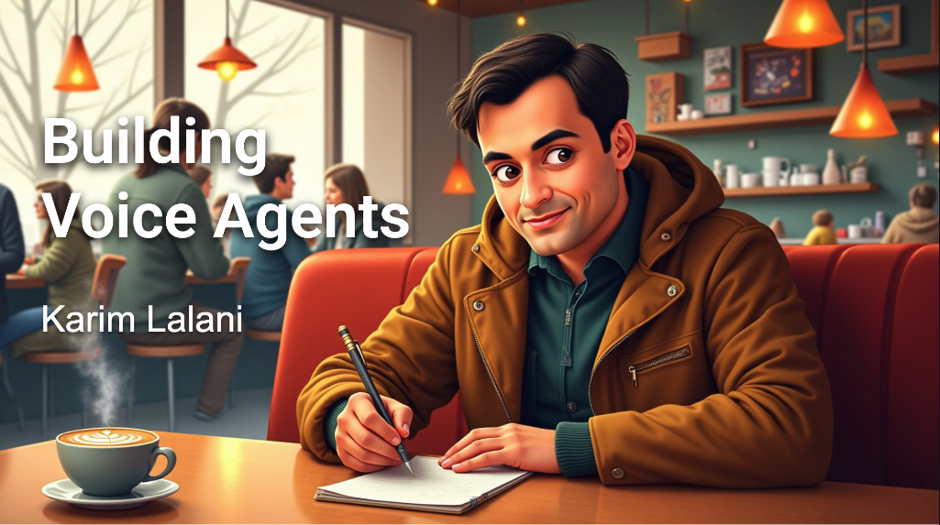
FastRTC Lab

Slide 28
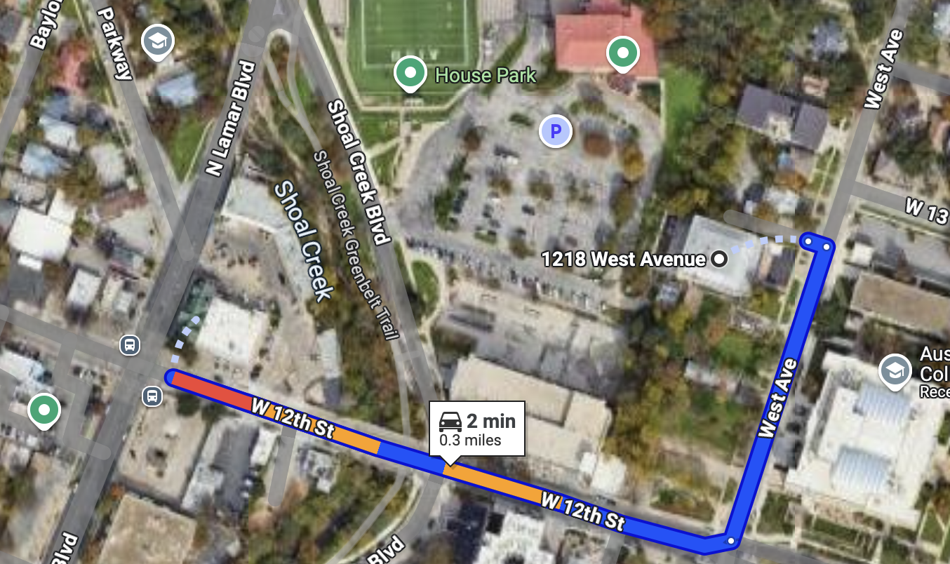
RGC-3000 and Tavern After Party
Website: aimug.org – All things LangChain and AIMUG.
Discord: Join us for ongoing conversations.
GitHub: Austin LangChain Repo – Check out our open-source projects.
Meetup: Austin LangChain Group
Twitter: @AustinLangChain – Latest updates and AI news.
YouTube: Austin LangChain Channel – Watch replays and tutorials.
ACC RGC3000
The Tavern
ACC Main Campus

Slide 29
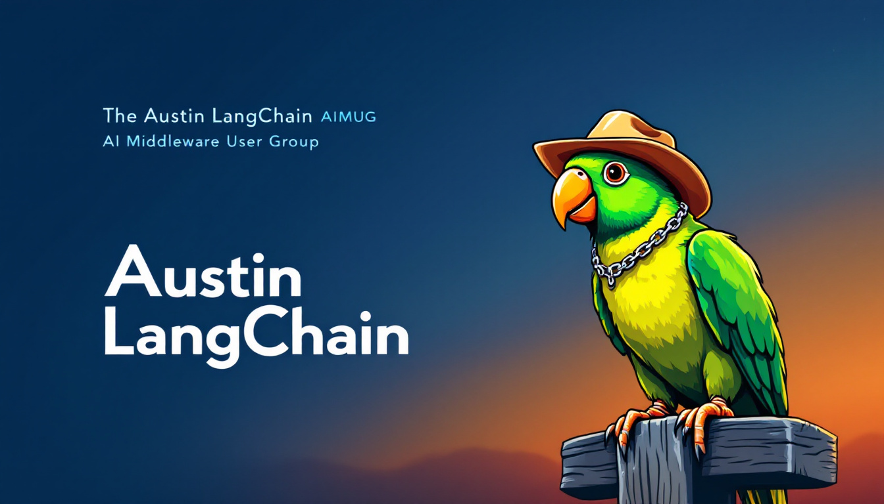

Slide 30
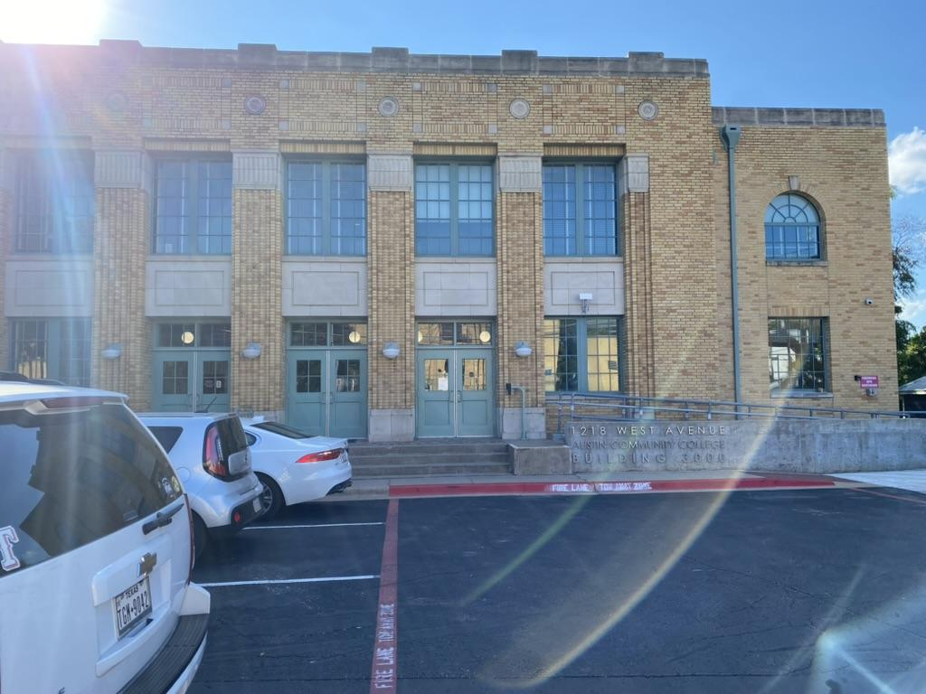
Finding US - ACC RGC-3000

Slide 31
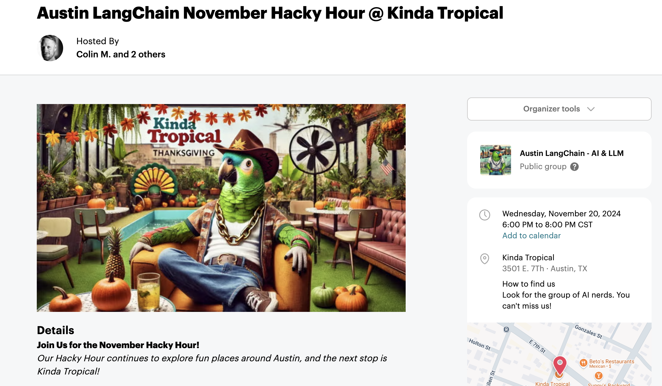
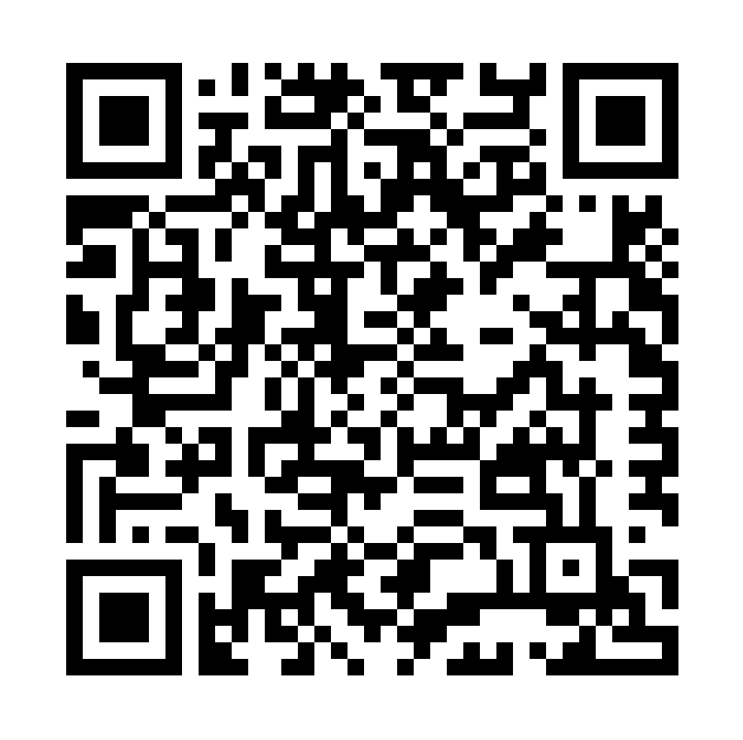
Next Event – Hacky Hour at Kinda Tropical
Respect & Inclusivity: Our only rule is simple: “Be cool to each other, don’t be gross.”
AI Enthusiasts of All Levels Welcome: We celebrate diverse perspectives and unique paths in AI.

